Slide 1
Interest Rate Prediction
(Lending Club)
Gautam Gowrishankar

Slide 2
The problem
Problem statement
Context
Dataset
Predicting Interest rates from Lending Club data.
Lending Club is a peer to peer lending company, in which investors provide funds for potential borrowers and investors earn a profit depending on the risk they take (the borrowers credit score).
Business Model:
Investors make money from interest. Based on the credit profile of each loan applicant, a grade IS assigned ranging from A1 to E5 with a corresponding interest rate.
Input:
The file is a matrix of about 890 thousand observations and 75 variables. These files contain complete loan data for all loans issued through the 2007-2015, including the current loan status (Current, Late, Fully Paid, etc.) and latest payment information.

Slide 3
Approach deep-dive
Stage 1
Stage 2
Stage 3
PRE-PROCESSING:
Feature engineering using feature tools package, transformation of raw data into features suitable for modeling
Feature selection, removing unnecessary features using RandomForest.
PREDICTION MODEL:
1.TPOT:
AutoML library.
2.NN:
Keras API
3.RandomForest:
scikit package
EVALUATION:
MAPE - Mean Absolute Percentage Error
MSE- Mean Squared Error
MAE - Mean Absolute Error
RMSE - Root Mean Squared Error

Slide 4
Implementation

Slide 5
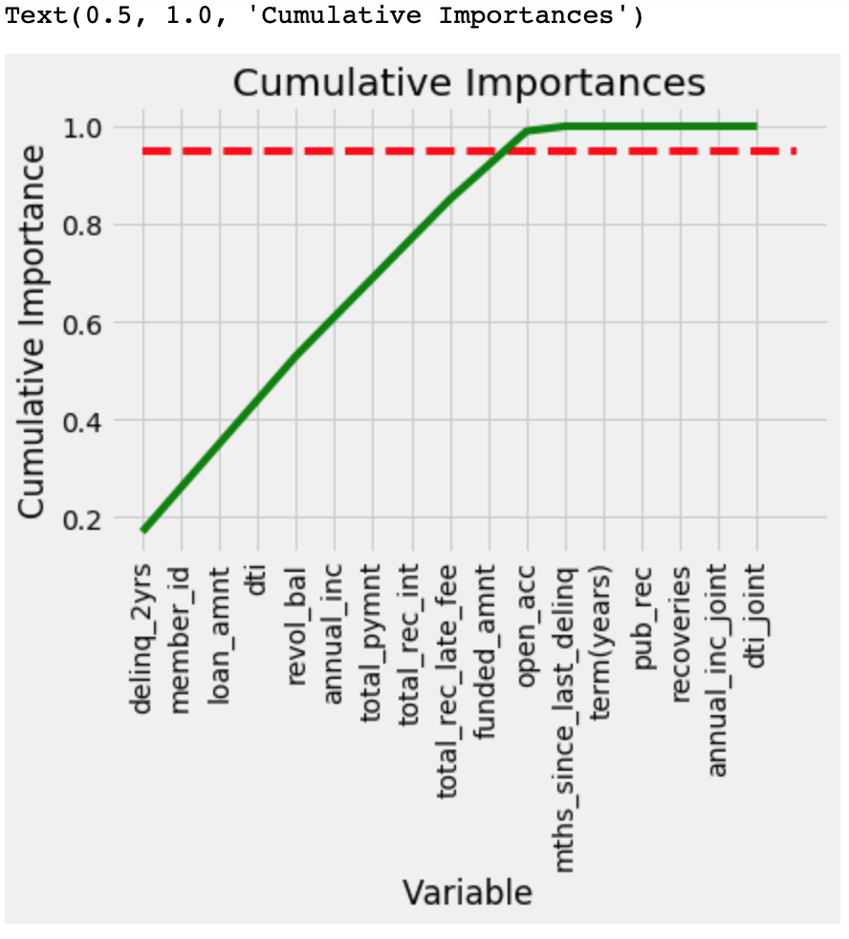
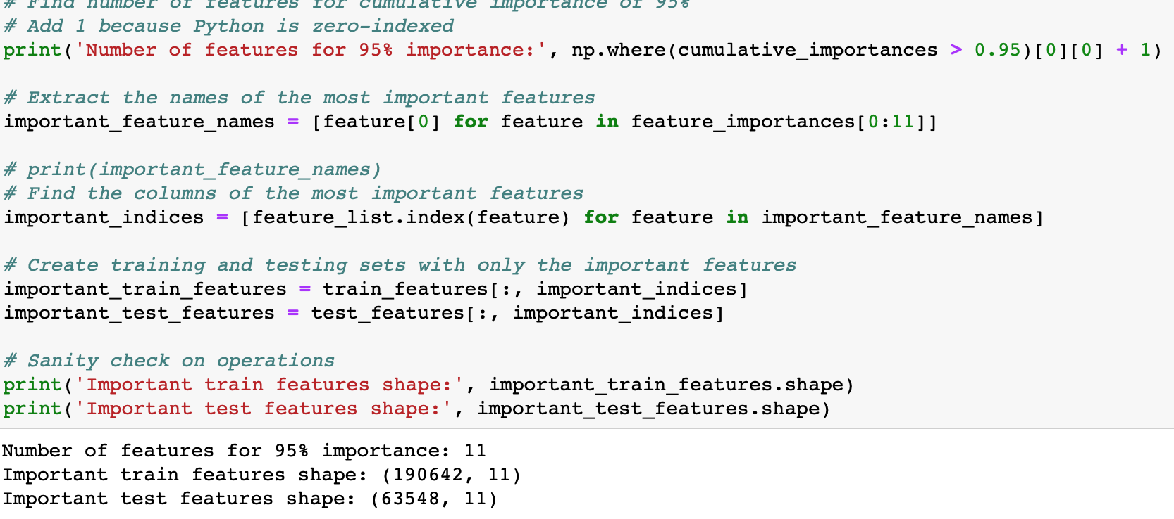
Feature Selection:
Getting rid of irrelevant or partially relevant features from the dataset as it can negatively impact the performance of the model.
Made use of RandomForest to extract the significant features.
Reduced the dimensions even further by calculating ‘cumulative importances’, filtered features that had a score of more than 0.95

Slide 6
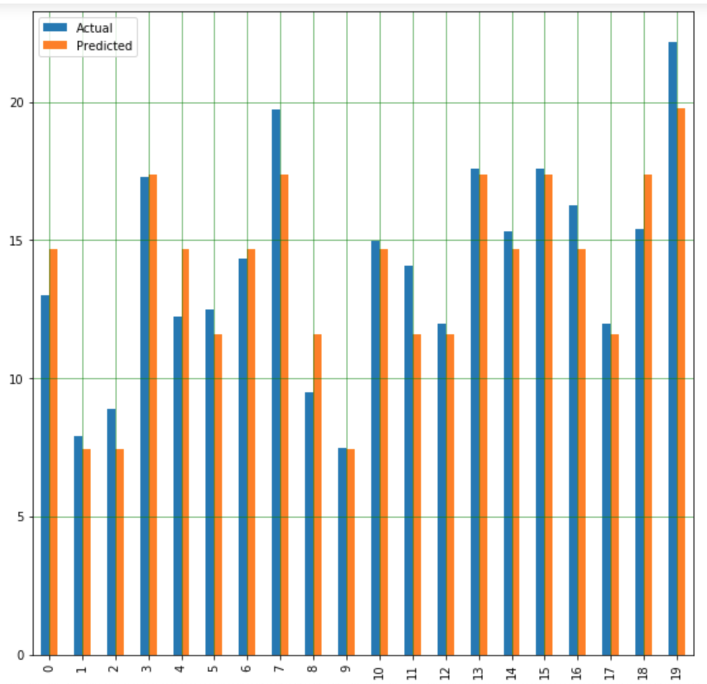
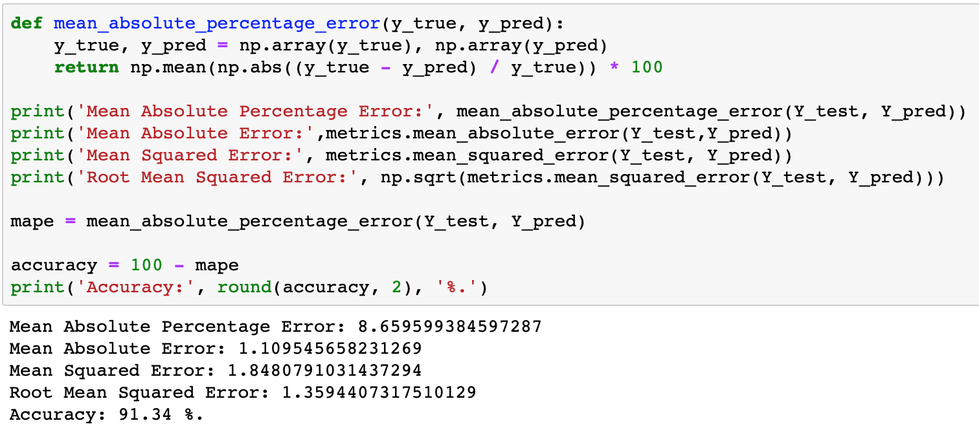
NEURAL NETWORK:
from keras.wrappers.scikit_learn import KerasRegressor
ADAM optimizer
Relu activation
Sequential layer
Test size: 0.25 (train_test_split)
91.34% Accuracy

Slide 7
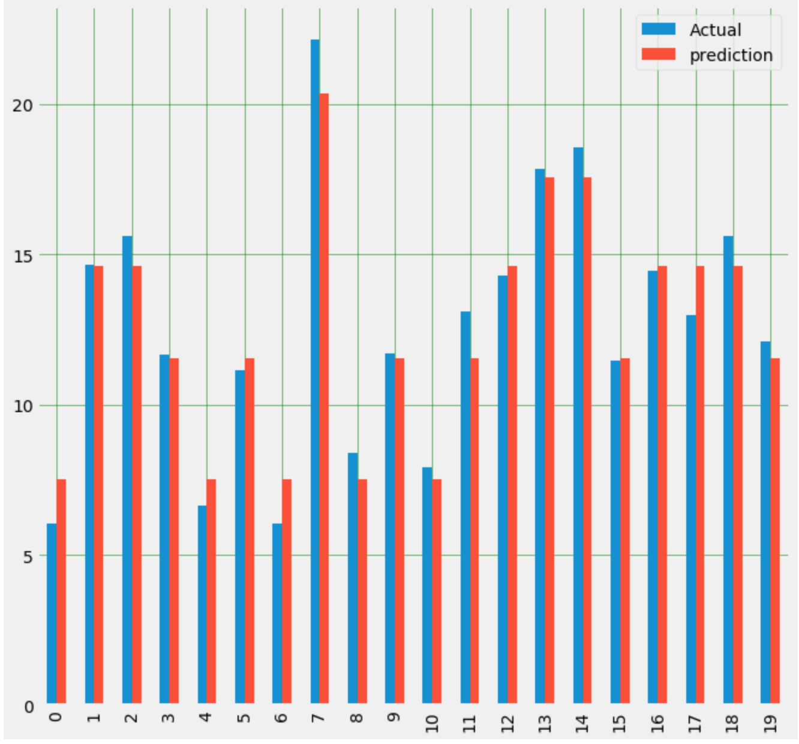
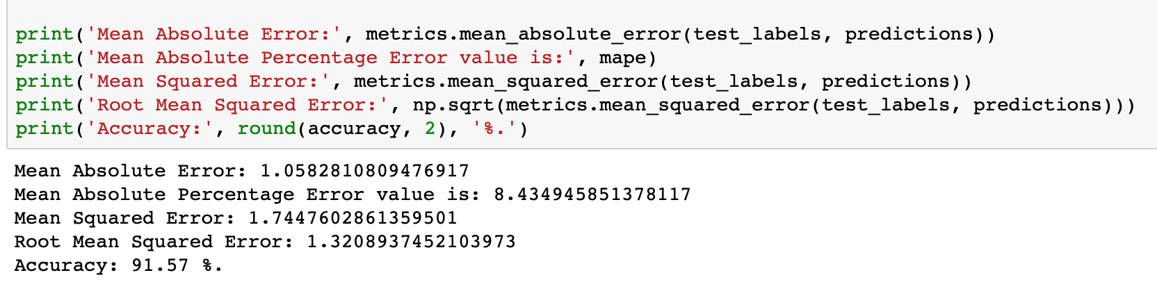
Random Forest:
from sklearn.ensemble import RandomForestRegressor
Extract important features
Limit number of features having cumulative importance of greater than 95
Test size: 0.25 (train_test_split)
91.57% Accuracy

Slide 8
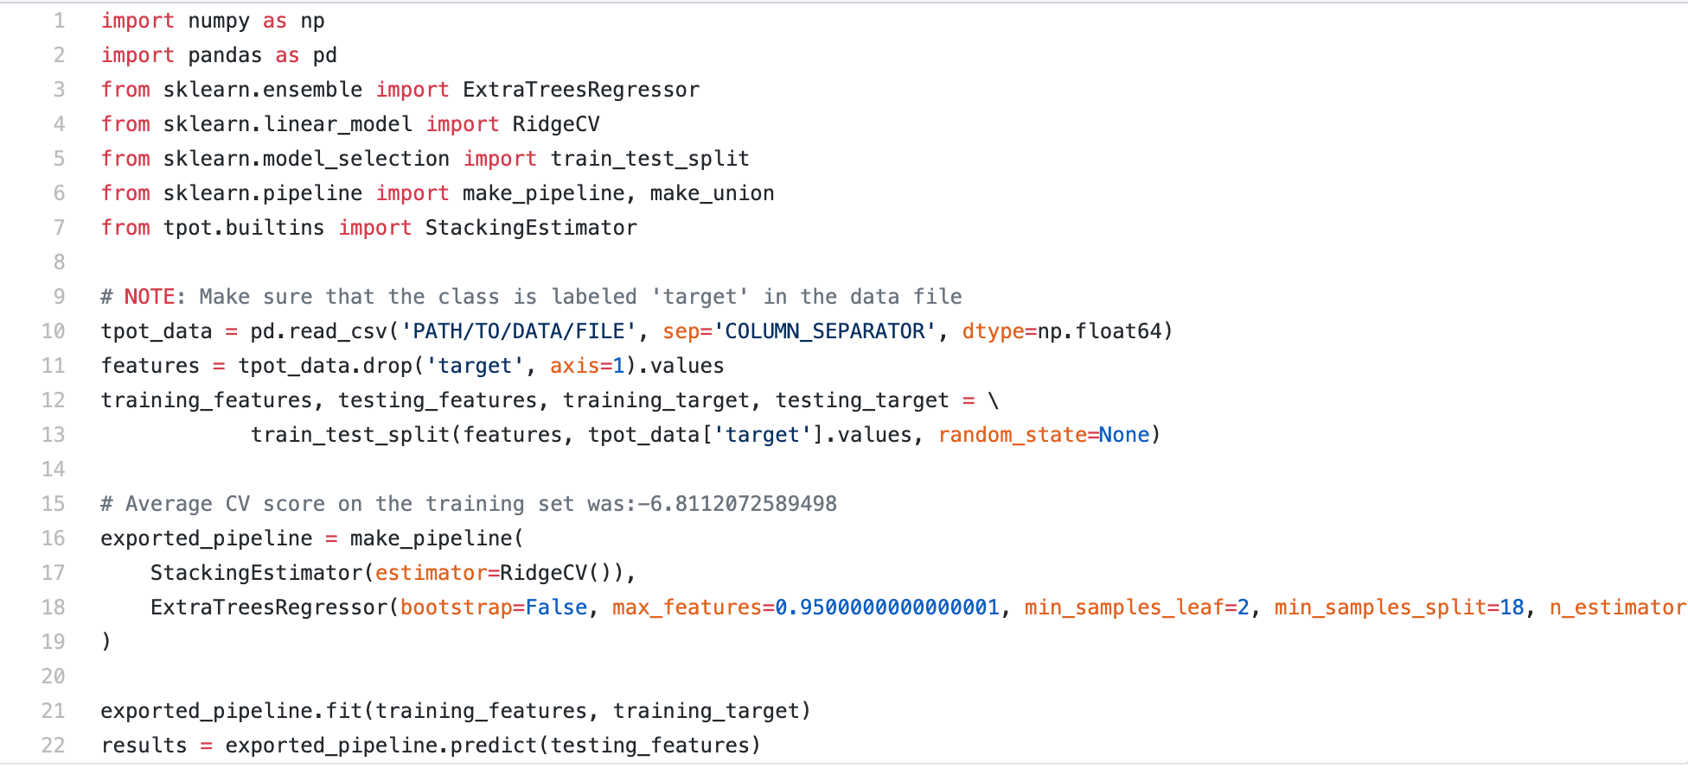
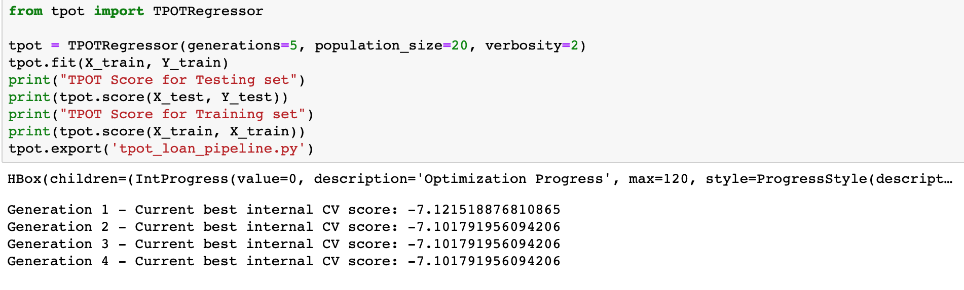
TPOT:
TPOT has what its developers call a genetic search algorithm to find the best parameters and model ensembles. TPOT tries a pipeline, evaluates its performance, and randomly changes parts of the pipeline in search of better performing algorithms.
CV Score of 7.1

Slide 9
fin -

